Slide 1
REDIS CACHE

Slide 2
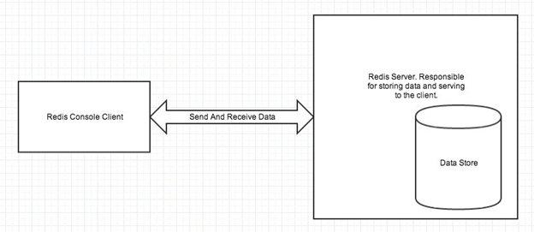
Redis is an open source (BSD licensed), in-memory data structure store used as a database, cache, message broker, and streaming engine.
Redis stands for REmote DIctionary Server.
Redis server is used to store data in memory . It controls all type of management and forms the main part of the architecture. You can create a Redis client or Redis console client when you install Redis application or you can use

Slide 3
CONFIGURATION:
@Bean public RedisCacheConfiguration cacheConfiguration() {
return RedisCacheConfiguration.defaultCacheConfig().entryTtl(Duration.ofMinutes(60)) .disableCachingNullValues()
.serializeValuesWith(SerializationPair.fromSerializer(new GenericJackson2JsonRedisSerializer())); }
TEMPLATE:
@Bean public RedisTemplate<String, Object> redisTemplate() { RedisTemplate<String, Object> template = new RedisTemplate<>(); template.setConnectionFactory(jedisConnectionFactory()); return template; }
@Bean JedisConnectionFactory jedisConnectionFactory() { JedisConnectionFactory jedisConFactory = new JedisConnectionFactory(); jedisConFactory.setHostName("localhost"); jedisConFactory.setPort(6379); return jedisConFactory; }
we defined a RedisTemplate using the jedisConnectionFactory. This can be used for querying data with a custom repository.

Slide 4
ANNOTATIONS:
@Configuration
@EnableCaching
@Cacheable-to enable caching behavior for a method
@CacheEvict- to indicate the removal of one or more/all values
@CachePut- can update the content of the cache without interfering with the method execution. @CachePut will actually run the method and then put its results in the cache.
we can group multiple caching annotations with @Caching, and use it to implement our own customized caching logic.

